Slide 1
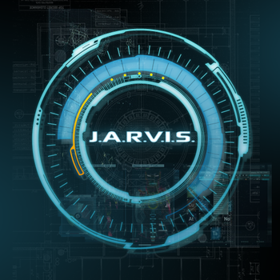
Enquiry system(Lady Jarvis)
User-Hello..
Jarvis-O hello sir...

Slide 2
Contents
About
Working
Step by step procedure
Future scope
Limitations
Reference

Slide 3
ABOUT
This is a system which makes conversation with user.
It gives the answers of the questions asked by the user.
This helps the user to get access of the website contents by just asking the machine such as the syllabus of particular subject.
This also converse in a user-friendly manner and helps them to know about the local area(where the system is installed) information such as direction or location of particular building.

Slide 4
WORKING
The working principle behind the system is the use of Machine Learning concept called NLTK and Chatterbot.
NLTK - is a platform used for building Python programs that work with human language data for applying in statistical natural language processing (NLP).
Chatterbot - is a Python library that makes it easy to generate automated responses to a user's input. Chatterbot uses a selection of machine learning algorithms to produce different types of responses. It trains itself by the training set provided by the admin.
Here we have used google speech recognition module for taking user voice as input and used python(text to speech convertor) for getting output in the form of voice.

Slide 5
Step by step procedure
The coding of this project is divided into two segments.(ADMIN and USER)
In the ADMIN section the system takes the request from the admin and updates the necessary files by the accessing the internet and downloading the contents automatically. The admin can also update the conversation files which help in conversation with USER.
In the USER section the user asks for help on particular topic and the system automatically generates or displays and speak the response. The responses or things to be displayed are stored and updated by the ADMIN in the system.

Slide 6
FUTURE SCOPE
This system can be implemented in private and public institutions like schools, hospitals, colleges, offices etc.
This will give a great help to public by avoiding long lines and chaos for getting information or making an enquiry. This bot will be installed in every administrative blocks and will make an ease for the public to get the information.

Slide 7
Limitations
There are few limitations in this system
--The system will work effectively in a noise free environment. To increase the performance we have to use a good quality mic which removes all the noise and get the user voice clearly as input.
--The internet connectivity should be good in order to preform the voice conversion actions effectively for better results as the system uses google voice synthesizer.
--Training should be done selectively for better conversation.

Slide 8
Reference
https://chatterbot.readthedocs.io/en/stable/

Slide 9
JARVIS – Hope you like my creator’s IDEA…
THANK YOU

